Slide 1
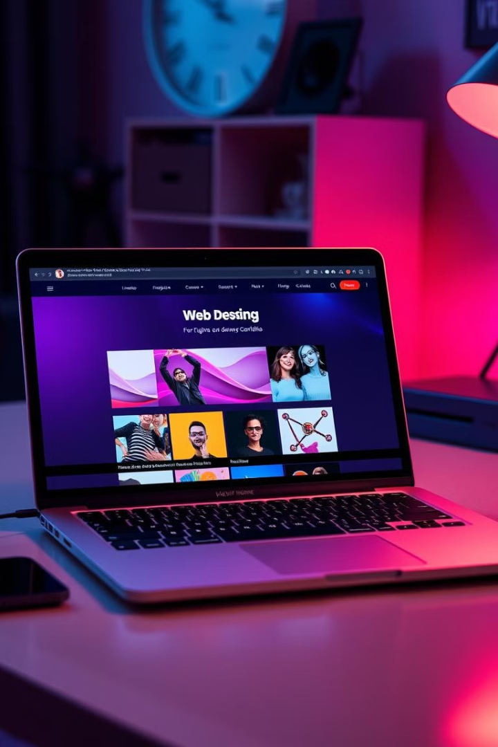
Anushka Singh's Portfolio
Welcome to my portfolio! I'm Anushka Singh, a dedicated 2nd-year Computer Science student specializing in web development. This portfolio showcases my design philosophy, technical skills, and a collection of projects that demonstrate my ability to craft engaging user interfaces using HTML and CSS. As an aspiring web designer, I'm passionate about creating impactful digital solutions and constantly expanding my knowledge of new technologies.
Explore my work to see how I bring ideas to life through seamless interactions and visually appealing designs. From cloning popular platforms to developing personal websites, each project reflects my commitment to user-friendly interfaces and clean, efficient code.

Slide 2

Portfolio Overview
Sidebar Navigation
1
A fixed left sidebar featuring the designer's name and a menu with links to About, Projects, Skills, and Contact sections.
2
Main Content Area
Divided into five sections: Introduction, About Me, Projects, Skills, and Contact information.
Footer
3
Contains a copyright notice asserting content rights.

Slide 3

Design Elements: HTML and CSS
The design of this portfolio, crafted solely with HTML and CSS, emphasizes a clean and minimalist aesthetic to showcase the work effectively. Utilizing a structured layout, the portfolio employs a grid system to organize content, ensuring easy navigation and a visually appealing experience. Custom styles, including a cohesive color palette and thoughtfully selected typography, enhance readability and create a professional tone.

Slide 4

Featured Projects
Spotify Clone
Personal Portfolio Website
Photographer Portfolio Website
A frontend replica of the popular music streaming platform, showcasing core features and user experience using HTML and CSS.
A self-designed and developed website to showcase web design skills and projects, creating an engaging online presence.
A custom-designed portfolio for a photographer, featuring layout and user interface design to showcase their work and services.

Slide 5





My Technical Skills
HTML & CSS
Java
Python
C & C++
Proficient in creating structured, styled web pages
Experienced in object-oriented programming
Skilled in versatile scripting and application development
Knowledgeable in low-level programming languages

Slide 6

Contact Information
1
Email
2
LinkedIn
3
GitHub
anushka.2327cse1234@kiet.edu
linkedin.com/in/anushka-singh-47b4a6335
github.com/AnushkaSingh5

